Slide 1
Robust Automatic Detection and Extraction of a Document in an Images
Detect a document in an image, crop and transform to flatten it and reduce to black and white
By Christopher Skorka

Slide 2
Introduction
Detects the document in the image
Detect corners
Detect edges and hough lines, group similar lines and find intersections
Detect 4 cornered contours
Combine the data to determine the 4 corners
Local search to estimate parameters for the above tasks
Crop and transform the image to flatten the document
Recued colours to black and white (optional)
Using Otsu’s method.
Thresholds gradient to overcome shadow gradients

Slide 3
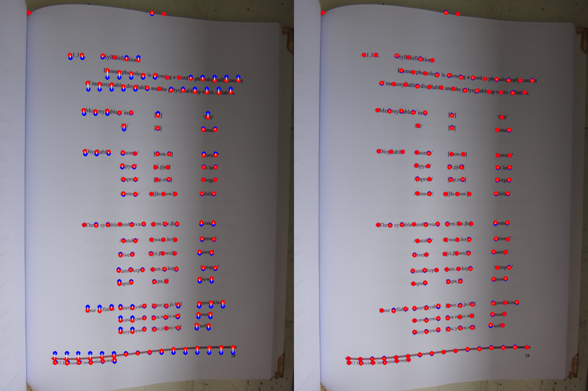
Previous work
Detecting contours
Using a only contours my not be as accurate as possible
De-wrapping by detecting horizontal lines of text
calculates transformations from these lines.
Requires horizontal text
Requires image from directly above
https://mzucker.github.io/2016/08/15/page-dewarping.html

Slide 4
Technical approach
Preparation
Gaussian smoothing
Closing (dilating and eroding)
Corner detection
Harris corner detection
Dilate to points
Edge detection
Canny edge detection
Hough lines
Contour detection
Contour from canny edge
Filter polygons of degree 4
Detect document
Match hough line intersections with corners
Image transformation
Transform corners of the page to the full image
Color thresholding
Otsu’s method to produce a binary image

Slide 5
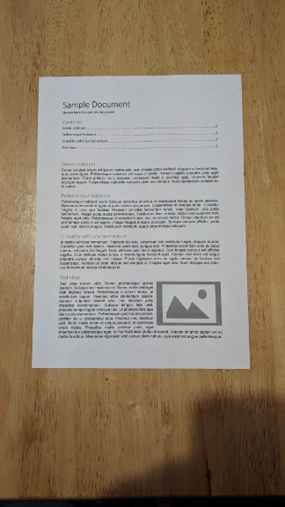

Gaussian smoothing
Original
Smoothed

Slide 6
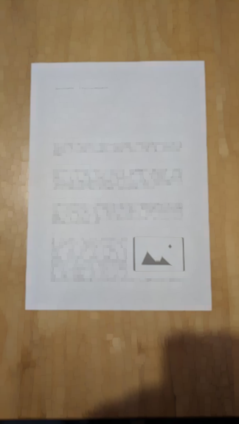
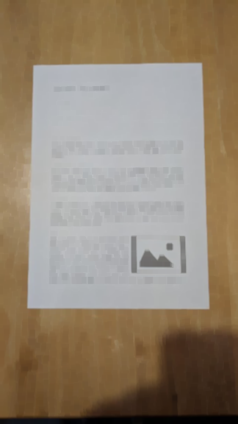
Closing (dilating and eroding)
Dilated
Eroded

Slide 7
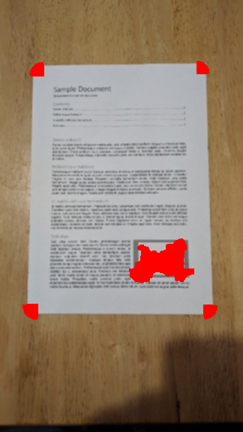
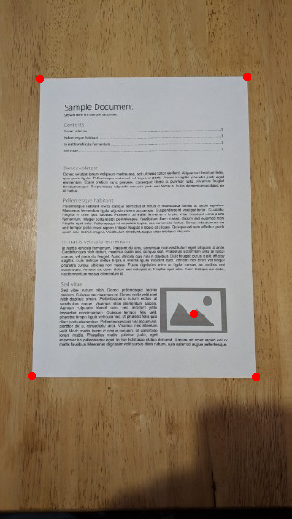
Corner detection
Harris corner detection
Eroded corners
Detects centres of each corner blob
Not yet implemented

Slide 8
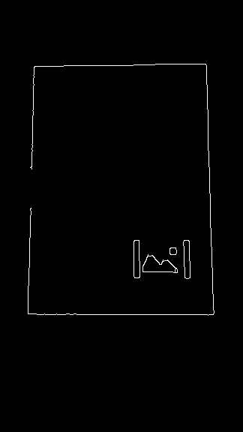
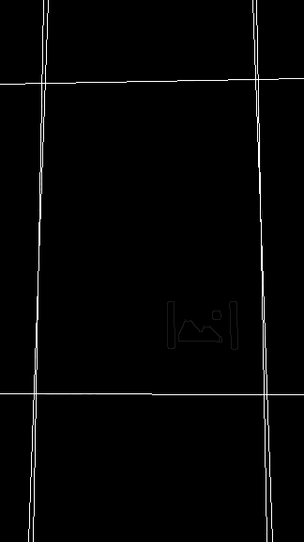
Edge detection
Canny edge detection
Algorithm adjusts thresholds as needed
Hough lines
Similar lines will be merged

Slide 9
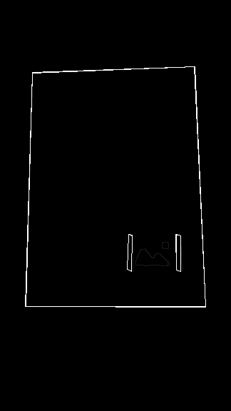
Contour detection
Canny edge detection
4 sided polygons

Slide 10
Detect document (not implemented)
Algorithm
Eg
Local search algorithm searches parameters until 4 corners are found with sufficient confidence
Repeatedly adjust canny parameters until
4 line intersections are mapped to 4 corners
If too many matches increase canny threshold
If too few matches decrease canny threshold

Slide 11
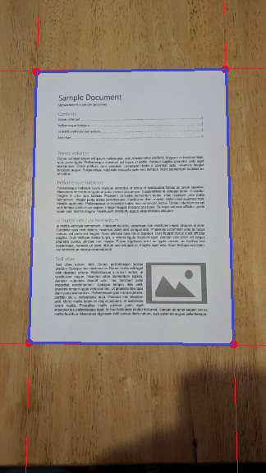
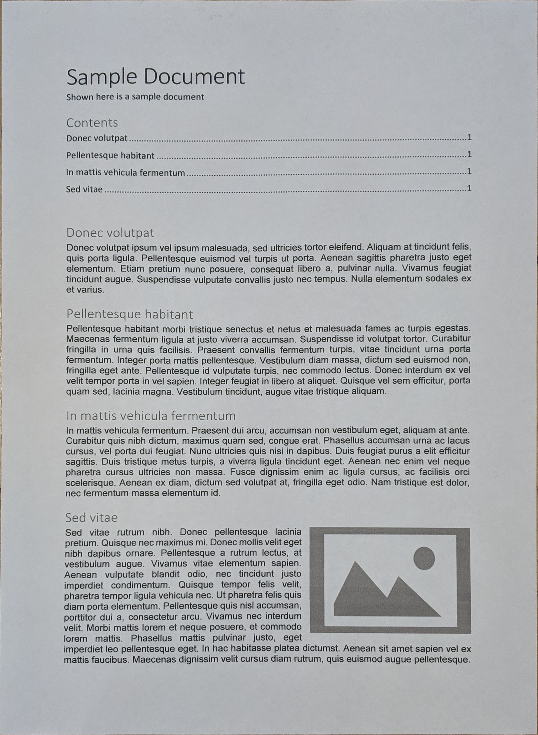
Image transform (not implemented)
Detected document
Transform flatten
Crop
Keep aspect ratio
(not yet implemented)
Transformed
Retain aspect ratio of document

Slide 12
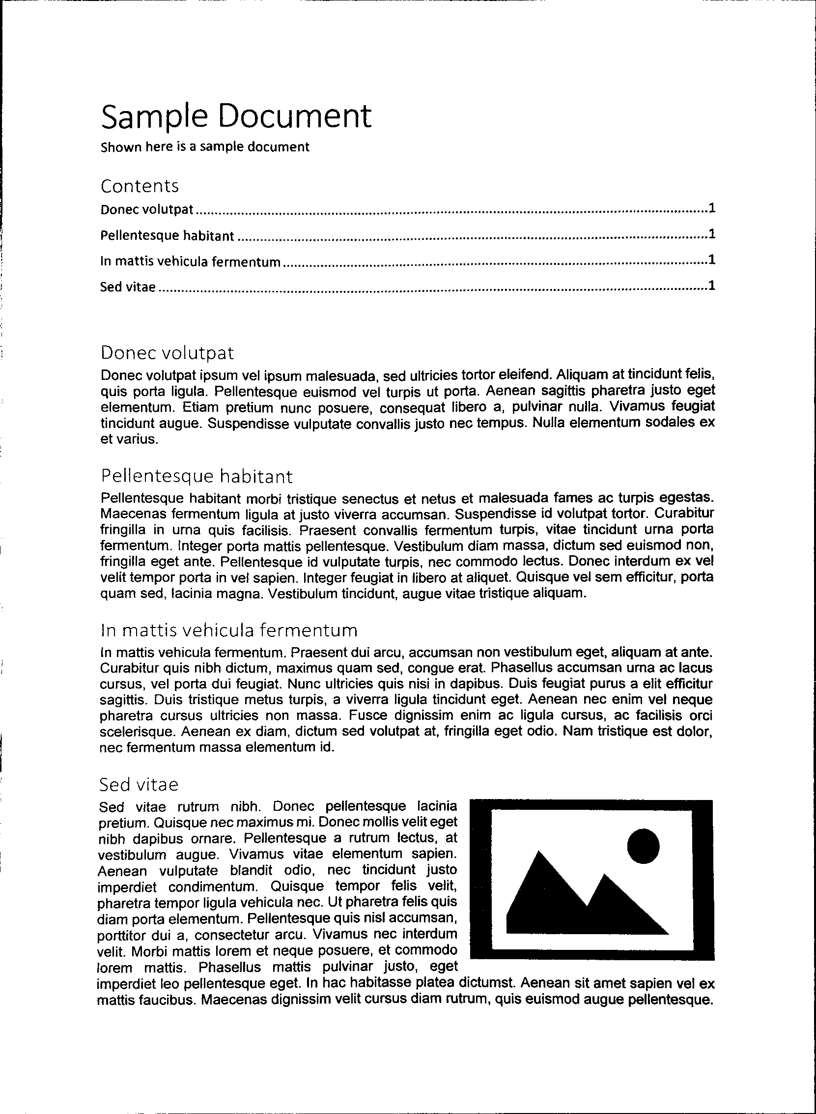
Color thresholding (Optional)
Transformed document
Binary coloured image
Limits the document to black and white

Slide 13
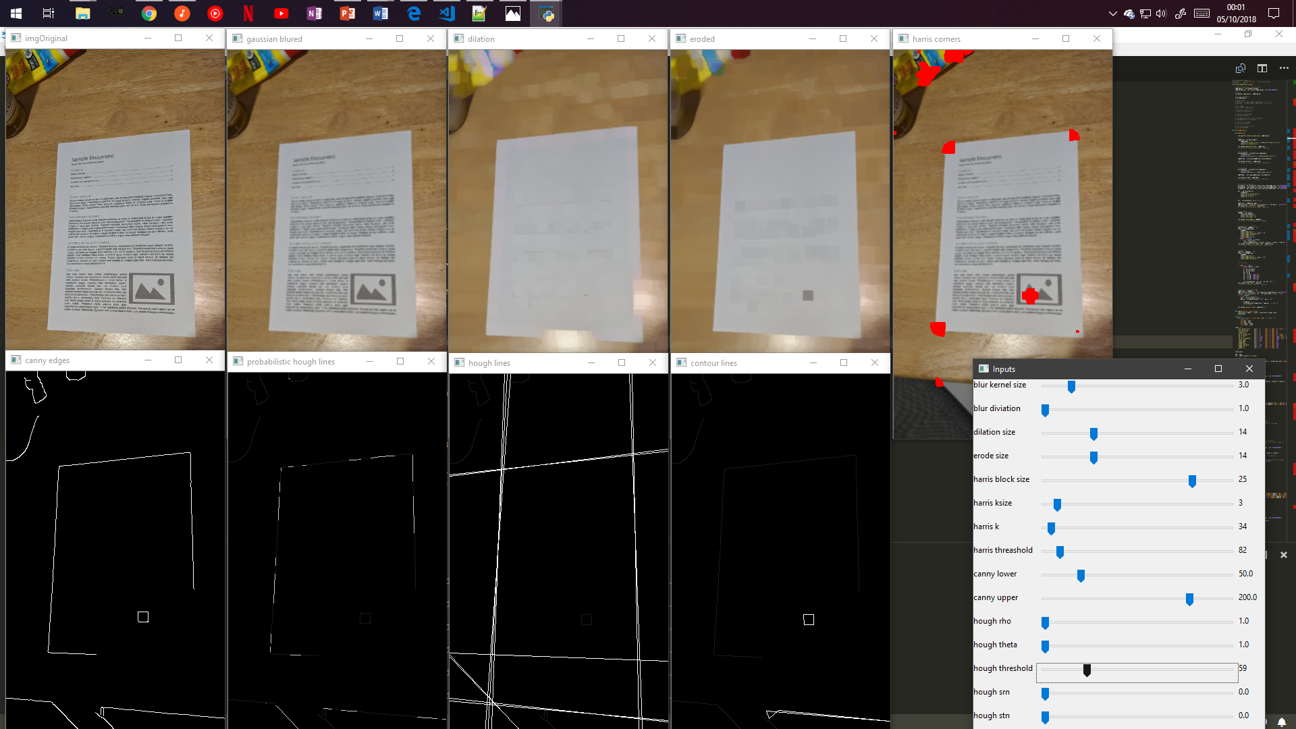
Result (so far)

Slide 14
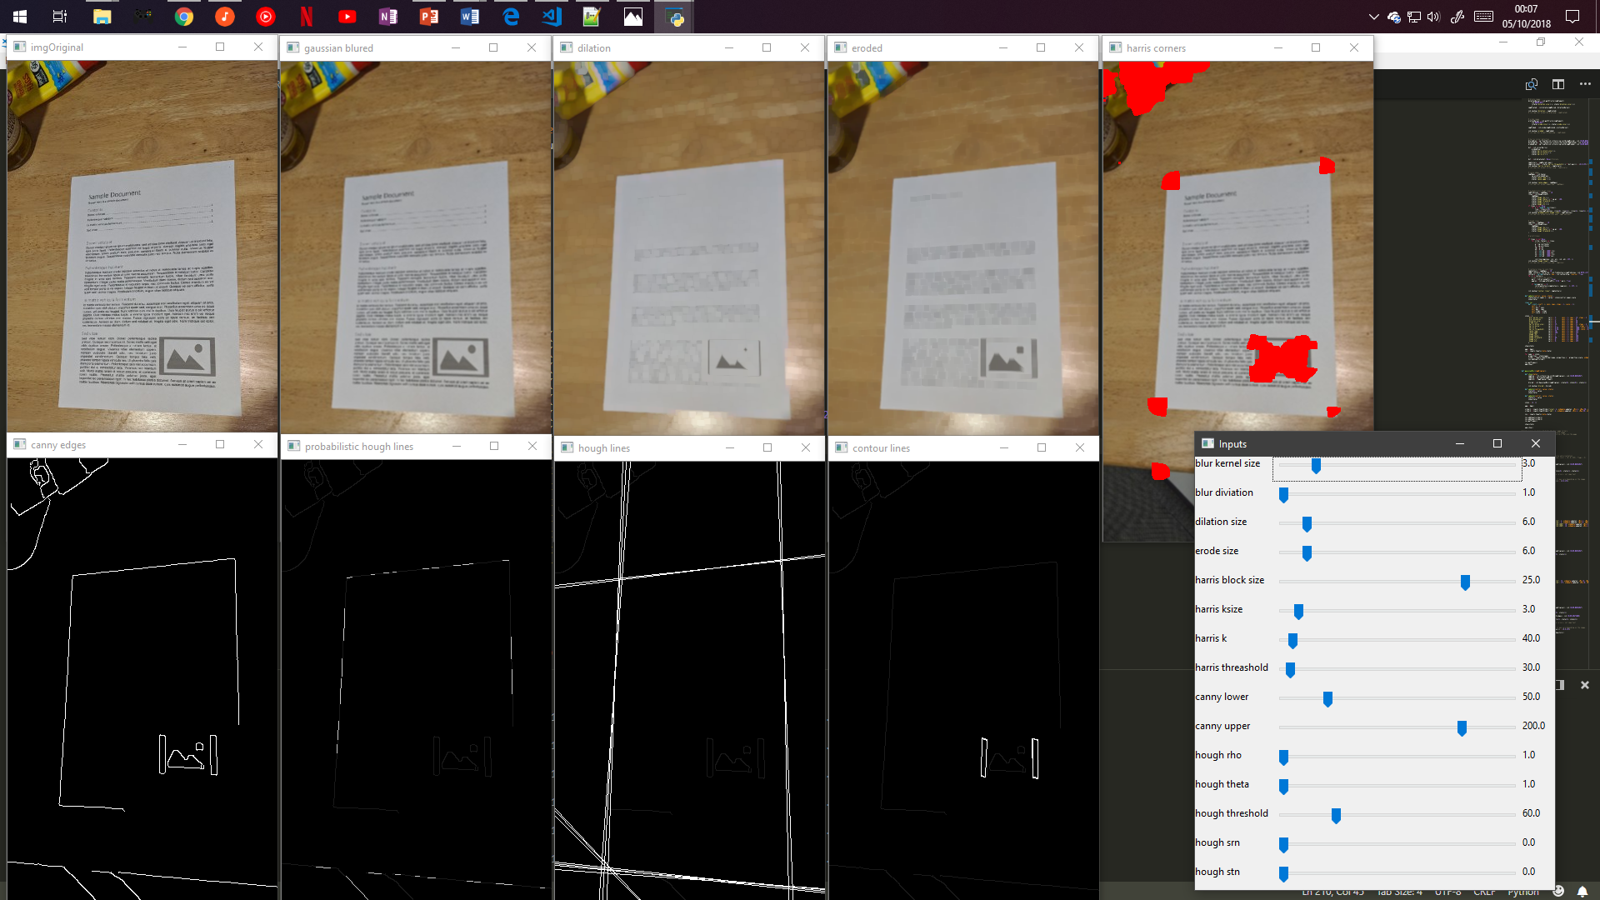
Result (so far)

Slide 15
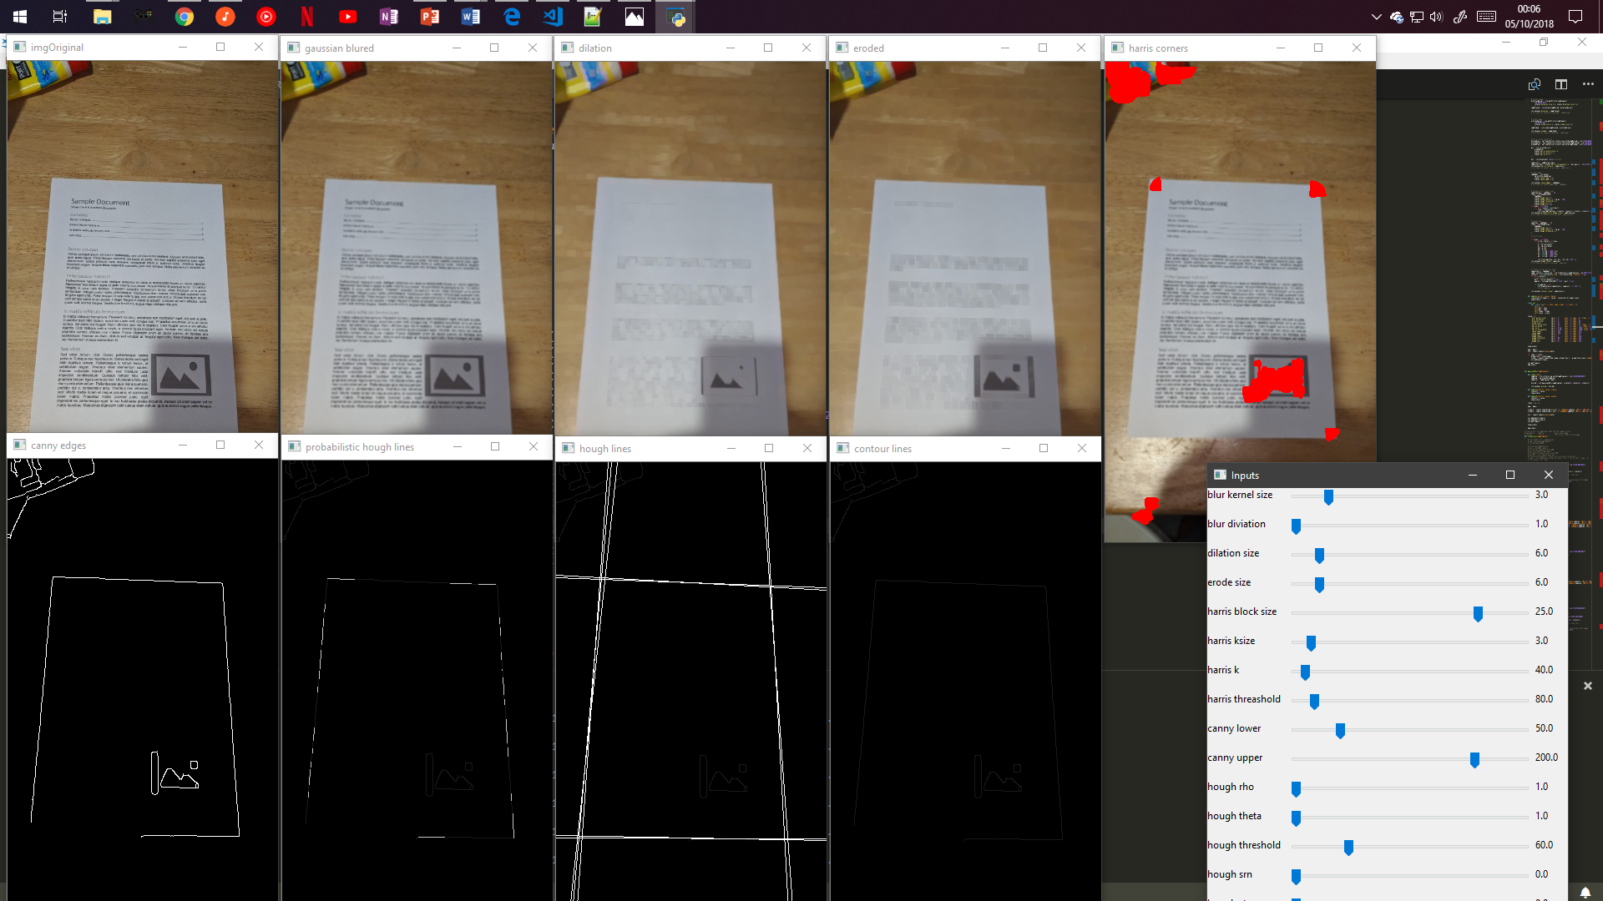
Result (so far)

Slide 16
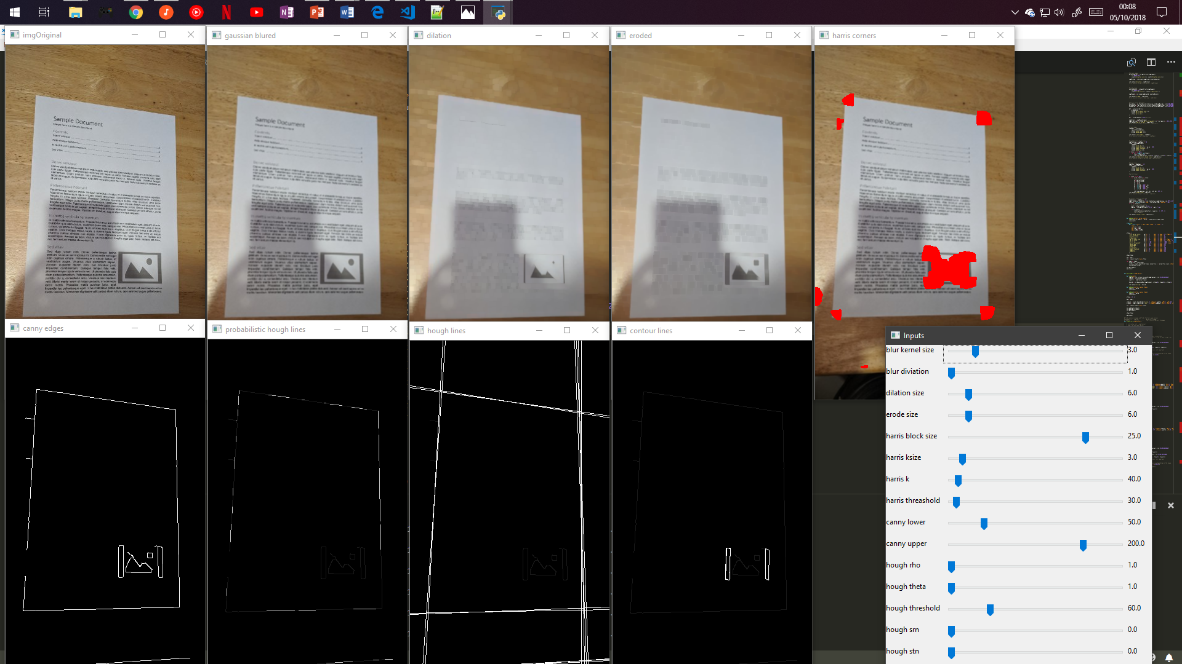
Result (so far)

Slide 17
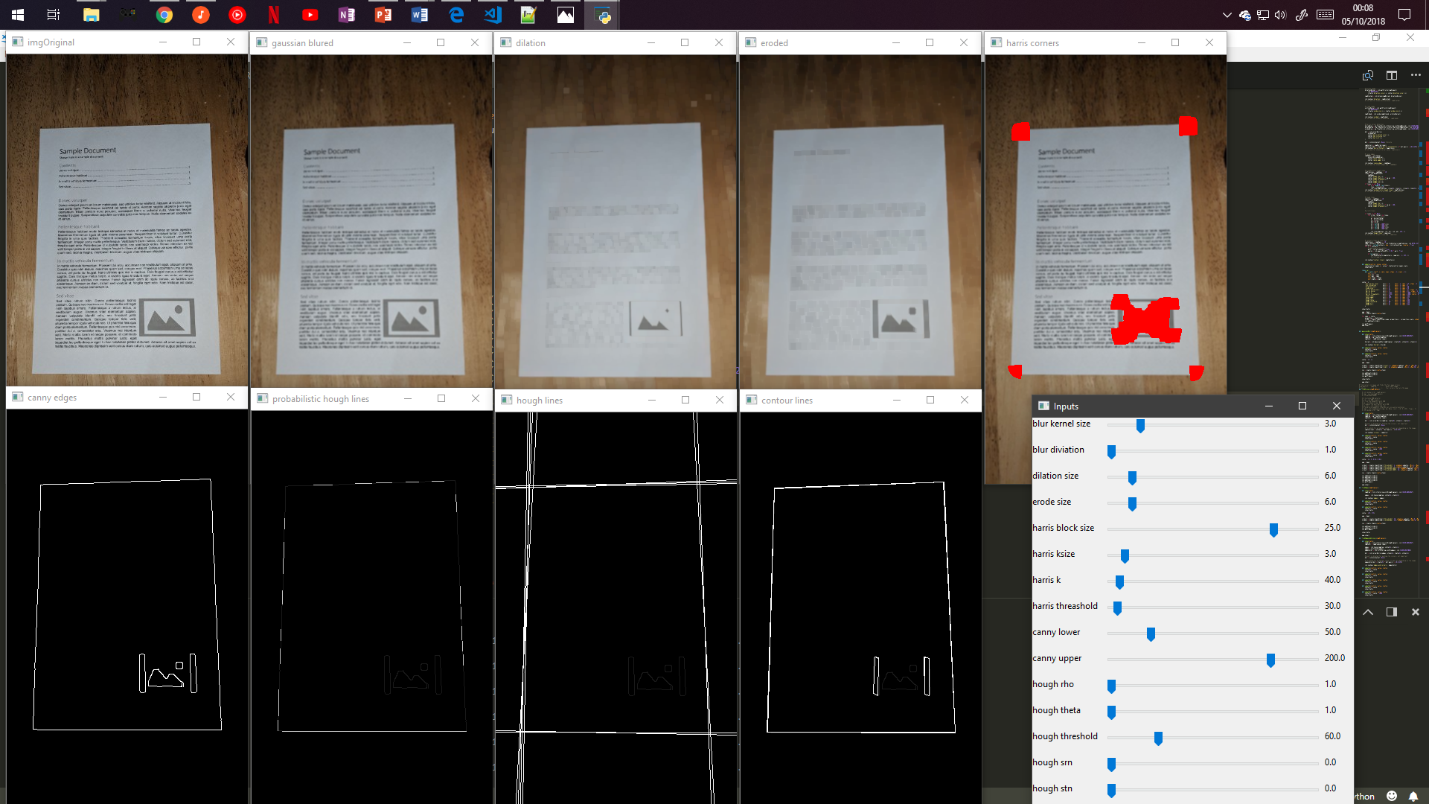
Result (so far)

Slide 18
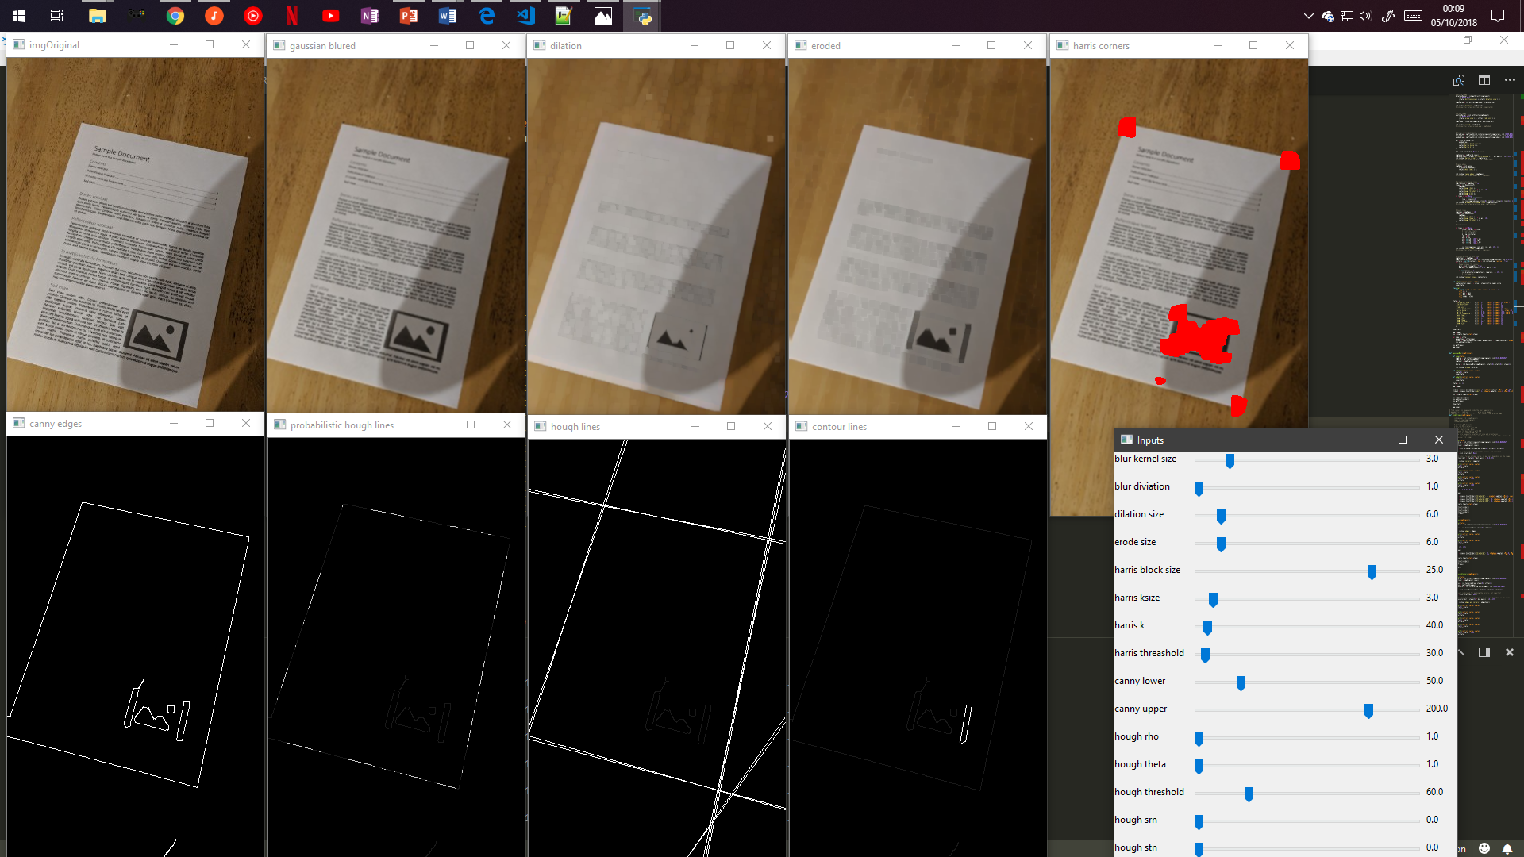
Result (so far)

Slide 19
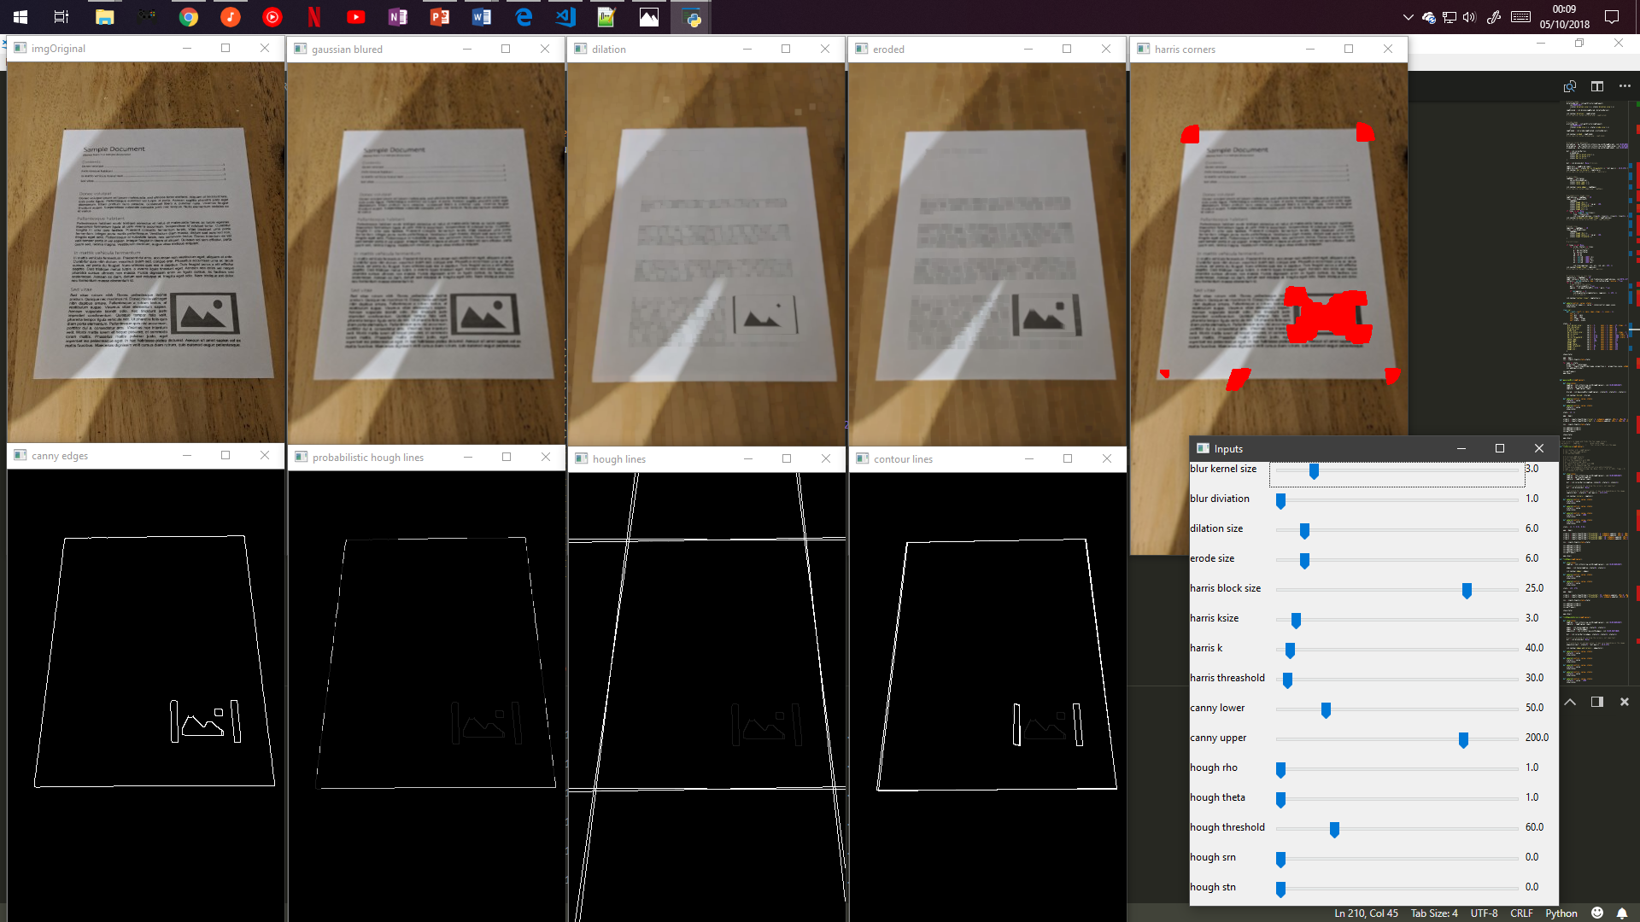
Result (so far)

Slide 20
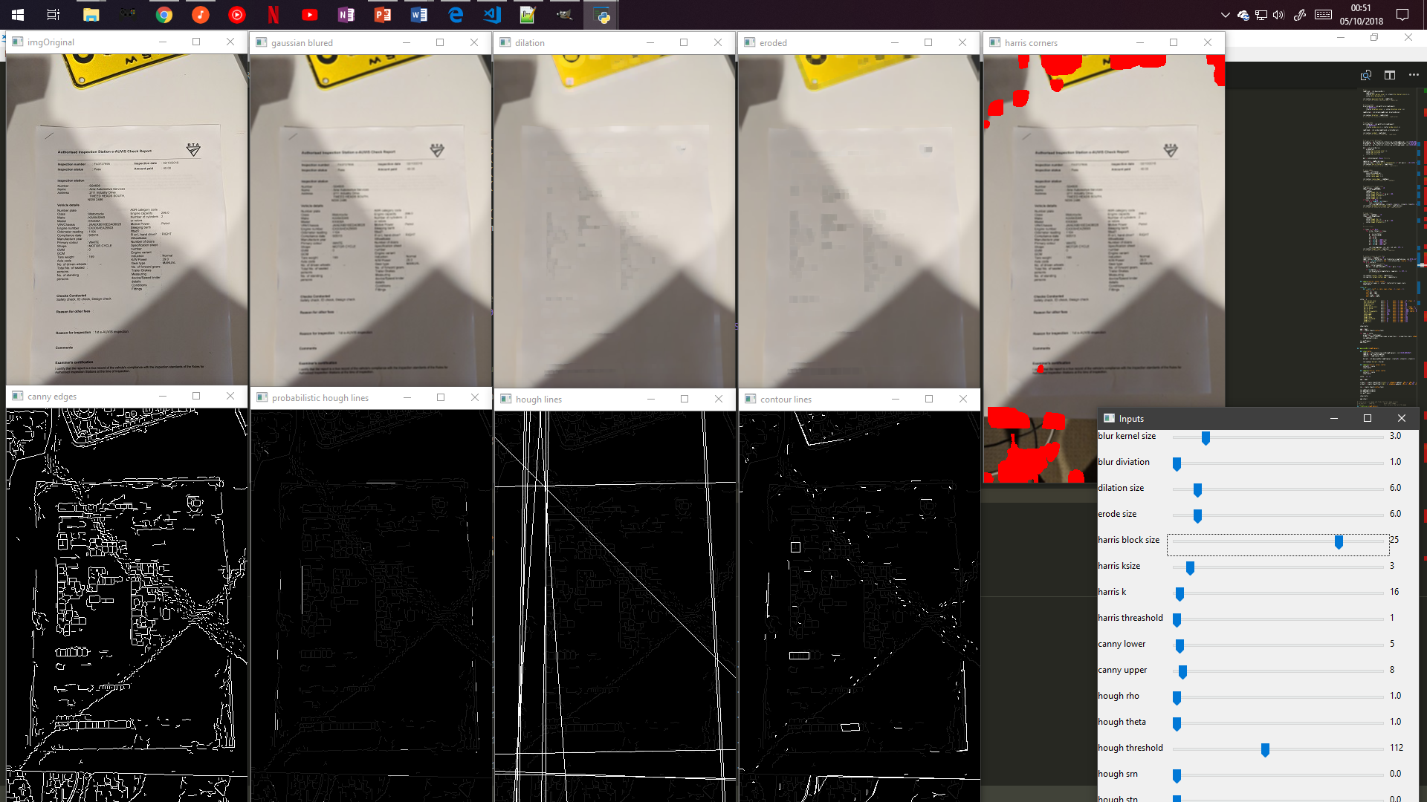
Result (so far)

Slide 21
Conclusion
This project is incomplete
Final results and benchmarks have not been established yet
Thus far results a promising
Corner, edge and line data is relatively reliable for ‘easy’ images
Still struggles with difficult problems
Remaining components need to be implemented before final evaluation

